Slide 1
Exploring Multimedia-Digital Audio representation
By: Yomna Mazhar - DECI student

Slide 2






All that we hear like animals sounds , our taking or music are invisible sound waves in the air.

Slide 3



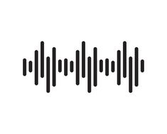


These sound waves become visible when we represent them as a files digitally on our computers and become digital audio.
Then save these waves on the computer as a file.
Frist: recording or capture
Sound waves.
Sound waves changes into visible waves by representing digitally ‘the digital audios’.

Slide 4
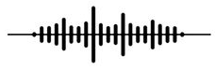
The representation of sound waves on computer are analog signals, which means they are continuous and vary in amplitude and frequency.
The ability of converting the physical sound waves into zeros and ones ‘‘binary ’’ is called analog to digital conversion ‘ADC’.
0101001001011
10110100111010
0011010101010

Slide 5
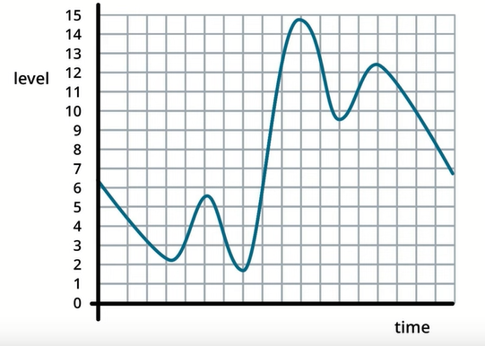
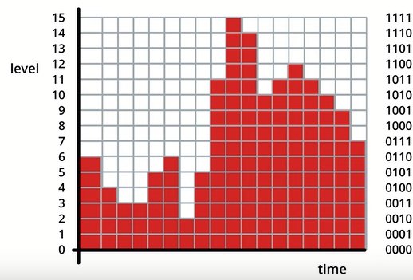
how does the computer microphones convert sound into binary data?
The sound has up and downs which splits into a graph which converted into samples each sample has a decimal number which converted to binary by digital converter … these ups and downs called ‘‘digital waves’’

Slide 6
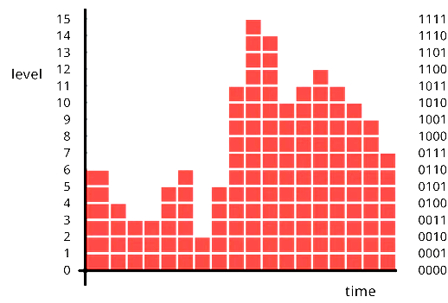
Digital waves can represented in digital data very
accurately if digital converter takes millions of
samples and the sound will be high quality.
If the digital converter take a few samples the audio will sound bad and poorly because losing
of some data of the physical sound waves.

Slide 7


When information from the world is captured and made digital, like sound waves, capturing as much information as possible results in the best quality information and the best sound.

Slide 8

Very high-quality digital audio and video data is has too much of samples and simply too much information to store or stream and vise versa.
10 MB
more quality
More samples
More space
5 MB
Less quality
Less samples
Less space

Slide 9

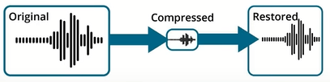
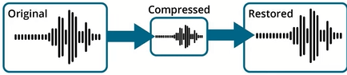
So we have to compress data according to the purpose or what we will use for and how it is into file formats
Compression classified into :
Lossless compression:
It is compression the data without losing informations ‘‘ do not reduce space ’’
Lossy compression:
It is compression data by losing some information that cannot restored ‘‘ reduce space ’’

Slide 10


Digital Audio Formats
Lossless :
FLAC (.flac)
WAV (.wav)
AIFF (.aiff)
DSF (.dsf)
Lossy :
MP3 (.mp3)
AAC (.aac)
OGG (.ogg)
WMA (.wma)

Slide 11

"streaming" the audio data means that The audio and video files are broken up and sent over the internet in small chunks, and arrive at your computer or device as you are listening

Slide 12
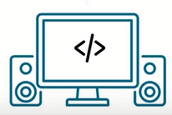
Code on servers and the web browser, and in mobile platforms sends or receives larger audio and video files in pieces over the internet.
bit rate : the of of information being sent over the internet how many bits per second are being sent from a server computer to your computer (bit per sec).by increasing the speed of internet the bit rate increases
bit depth :The amount of information in one of these streams .

Slide 13
Thanks a lot !
By: yomna mazhar

